Slide 1

Smart Intrusion Alert & Audit System
A PL/SQL Final Project Presentation
Student: Ushindi Bihame Victoire / Id: 27269
Lecturer: Mr. Eric Maniraguha
Course: Database Programming with PL/SQL
Institution: AUCA

Slide 2

The Imperative for Database Security
Protecting Sensitive Data
Mitigating Key Risks
Meeting Compliance Standards
Modern organizations handle vast amounts of confidential information: salaries, medical records, performance reports, and proprietary research data.
Critical risks include unauthorized data modification, lack of visibility into attempted breaches, manual policy enforcement errors, and the absence of a central audit trail.
Strict auditing is mandated by global compliance standards such as ISO 27001, GDPR, HIPAA, and Basel II, ensuring data integrity and legal adherence.
Why PL/SQL for Security?
Database-level Enforcement: Cannot be bypassed by external applications.
Real-time Execution: Guarantees immediate validation and action.
Application Independence: Does not rely on vulnerable application logic for security.

Slide 3
Project Objectives: Building a Robust Audit System
01
02
Pre-execution Detection
Automated DML Logging
Detect and prevent illegal modification attempts before they are executed.
Automatically log every DML action (INSERT/UPDATE/DELETE) with detailed context.
03
04
Comprehensive Tracking
Suspicious Behavior Alerts
Track user identity, exact timestamp, and client IP for each database interaction.
Generate immediate alerts when abnormal or suspicious activities are detected.
05
06
Traceability Reports
Database-level Accountability
Provide detailed, traceable reports to reconstruct event sequences.
Maintain and enforce accountability directly within the database infrastructure.
This system ensures a secure database model through packages implementing rules, trigger-based monitoring, and full lifecycle tracking of changes.

Slide 4

System Overview: Autonomous Intrusion Detection
What the System Does
Intercepts every record change attempt.
Validates against predefined business rules.
Logs all results into dedicated audit structures.
Detects irregular or unauthorized activities.
Assigns appropriate alert statuses to events.
The system operates autonomously, without reliance on an external user interface, ensuring constant, uncompromised security enforcement.
Role-Based Access
Date-Based Restrictions
Action-Based Alerts
Ensures users only perform actions aligned with their assigned roles.
Prevents modifications on weekends or designated holidays.
Triggers alerts for sensitive operations, such as DELETE commands.

Slide 5






Architectural Design & Execution Pipeline
Logical Flow
Client
SQL Command
Trigger
Security Logic (Package)
Audit Logging
Database
Core Modules
Execution Pipeline
Component
Description
User performs DML (INSERT/UPDATE/DELETE).
Trigger detects the action and intercepts it.
PACKAGE
Holds validation + logging procedures
Calls security package for validation.
TRIGGER
Intercepts DML operations
If validation fails, the operation is rejected.
If valid, the operation is allowed to proceed.
CONTEXT
Stores client IP address
All actions and outcomes are recorded in audit tables.
AUDIT TABLES
Stores all audit results

Slide 6

Entity-Relationship (ER) Model Summary
AUDIT_LOG
AUDIT_LOG ↔ SECURE_DATA
AUDIT_LOG ↔ USERS
AUDIT_DETAILS 1:N
owns → 1:N
USERS
SECURE_DATA
Entities Created
Justification
USERS: Stores user credentials and roles.
USERS: Enables individual accountability and role management.
SECURE_DATA: Contains the confidential data being protected.
AUDIT_LOG: Offers a concise overview of security events.
HOLIDAYS: Lists non-working days for access restrictions.
AUDIT_DETAILS: Supports deep dive analysis of specific data modifications.
AUDIT_LOG: Records high-level audit events.
Separation of Concerns: Distinct entities ensure data integrity and efficient querying for audit purposes.
AUDIT_DETAILS: Provides granular, row-level tracking of changes.

Slide 7

Business Rules: Database-Level Enforcement
These rules are automatically enforced without user awareness, ensuring robust and consistent security.
1
2
Role-Based Modification
Calendar Enforcement
Access is strictly controlled by user roles:
Employees are prohibited from modifying records:
ADMIN: Full read/write/delete access.
AUDITOR: Read and delete capabilities.
On Weekdays: Monday through Friday are restricted.
EMPLOYEE: Limited to specific insert operations.
On Registered Holidays: Days listed in the HOLIDAYS table are blocked.
3
DELETE Action Policy
Any attempt by an employee to perform a DELETE operation will:
Generate an Alert: Immediate notification of the sensitive action.
Log the Attempt: Comprehensive recording of the event.

Slide 8

Security Package: Functional Overview
1
2
3
Core Objects
Internal Actions
Packaging Advantages
log_audit(...)
Automatic time stamping of events.
Promotes extensive code reuse.
send_alert(...)
Binding client IP addresses to each action.
Centralizes critical decision-making logic.
is_public_holiday(date)
Sophisticated alert labeling and categorization.
Streamlines maintenance and updates.
is_weekday(date)
check_business_rules(...)
Defining event status: NORMAL or SUSPICIOUS.

Slide 9
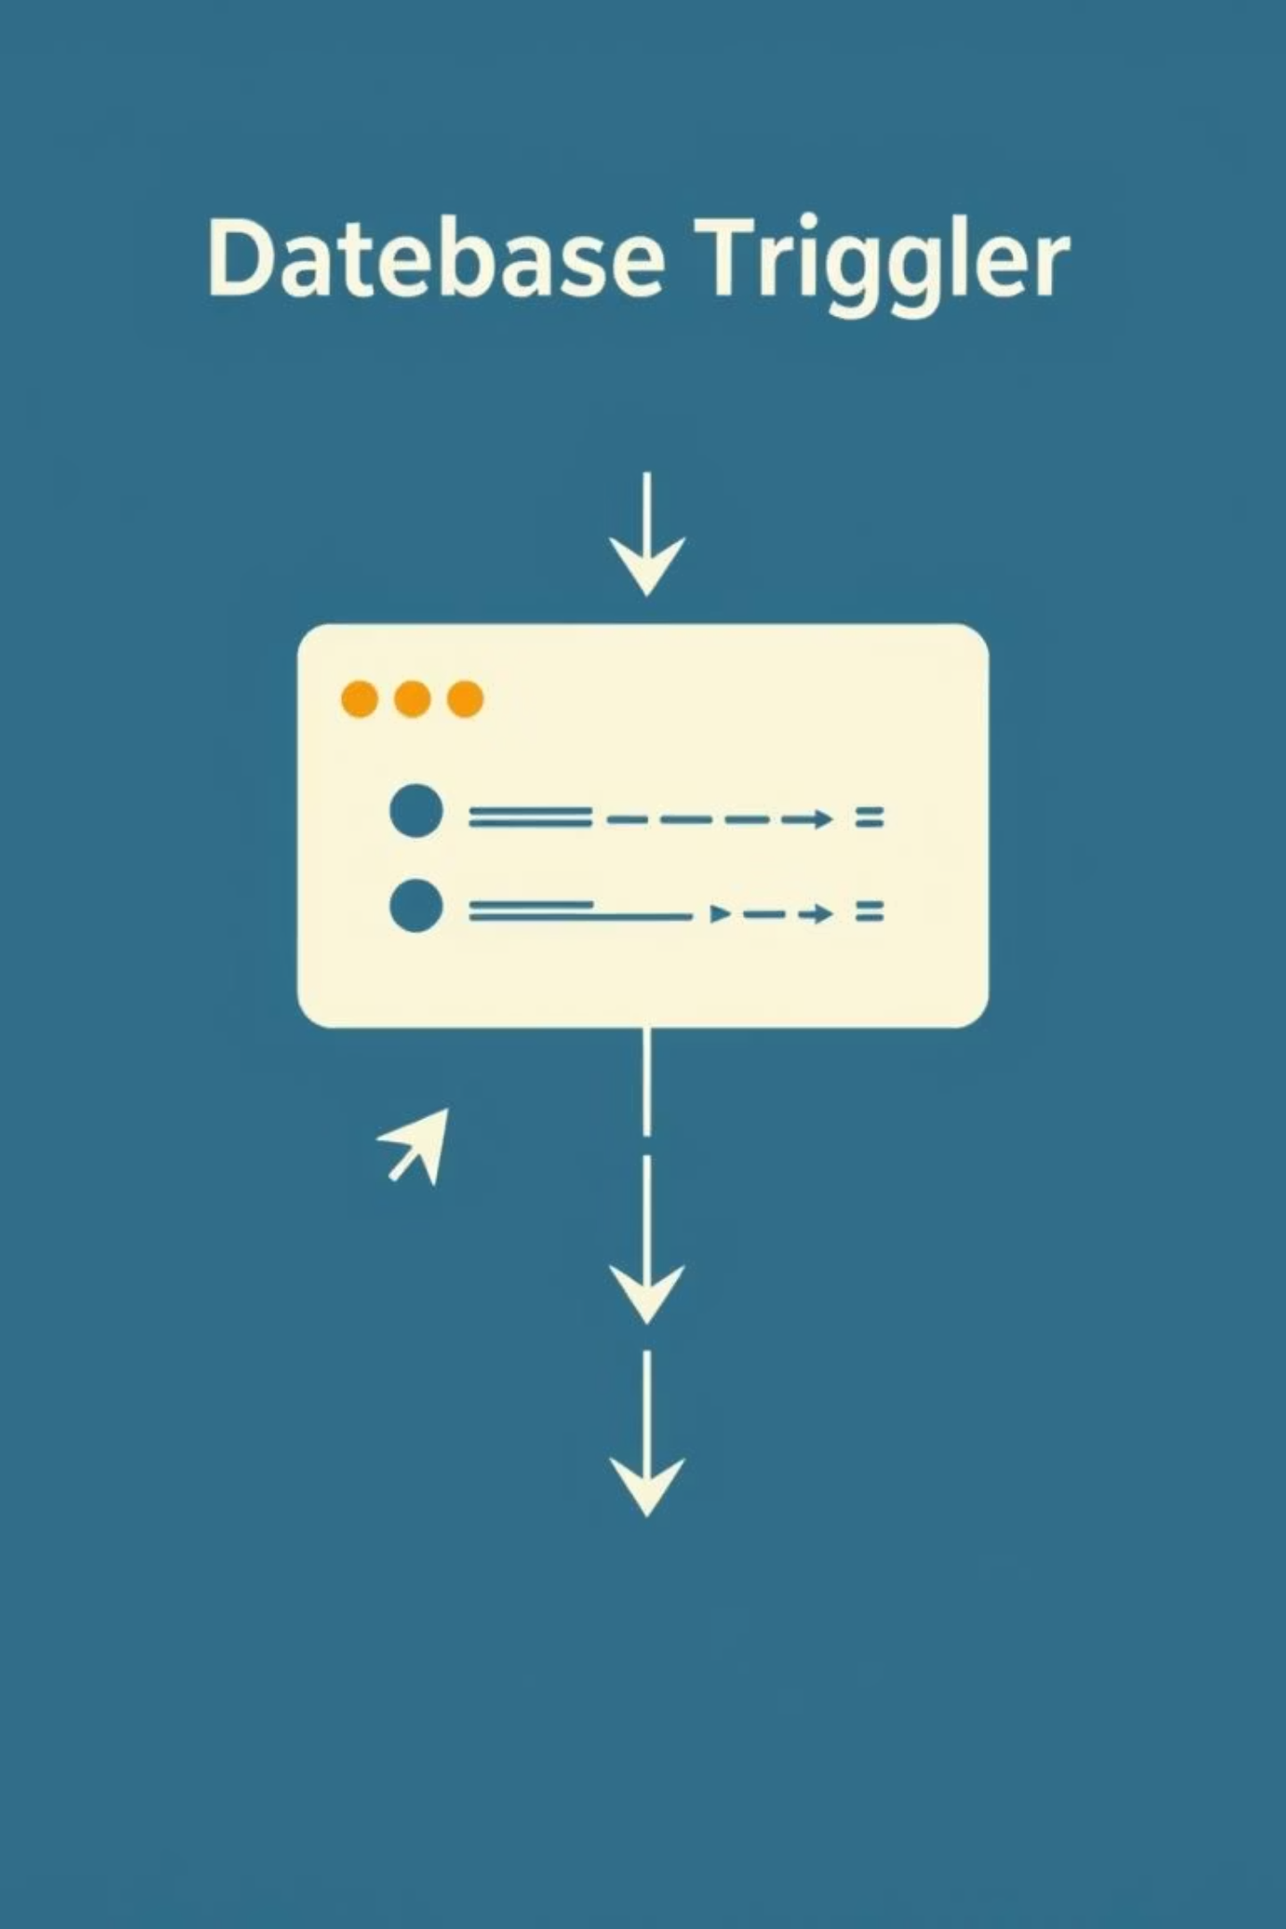
Trigger: Functional Responsibilities
Trigger Name: trg_secure_data_audit
Trigger Scope
The trigger executes BEFORE EACH ROW and BEFORE STATEMENT to ensure comprehensive interception of all DML operations.
Control Behavior
Detects the exact DML operation type (INSERT/UPDATE/DELETE).
Extracts the logged-in database username for accountability.
Reads the client IP address using SYS_CONTEXT.
Delegates complex security logic to the dedicated package.
Based on package validation, either allows or fails the transaction.
CRITICAL: Due to the precise timing of trigger execution, users are unable to bypass the established security rules, guaranteeing robust enforcement.

Slide 10
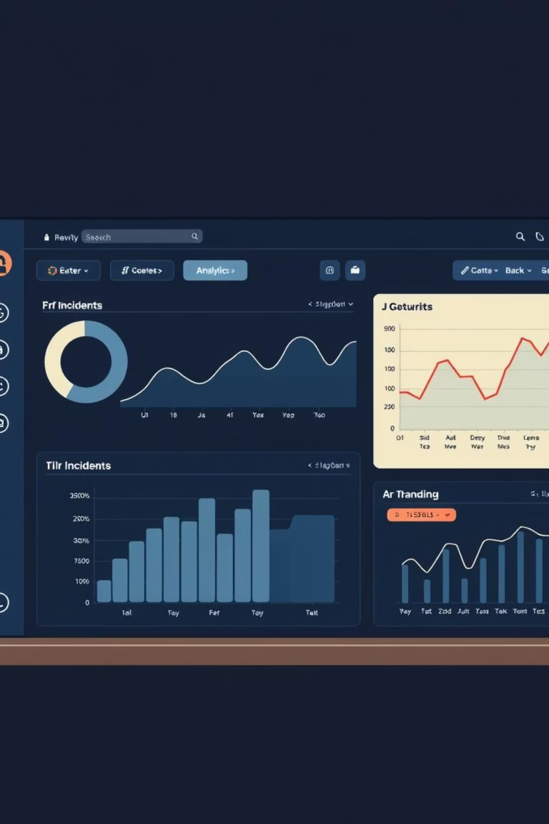
Validation: Test Case Results Summary
Test A: Employee Weekday Update
Test B: Unauthorized Delete Attempt
Outcome: UPDATE rejected.
Outcome: Operation marked SUSPICIOUS.
Status: Error returned, entry recorded as DENIED.
Status: Alert generated, record logged.
Test C: Successful Permitted Insert
Outcome: Operation ACCEPTED and recorded.
Status: Logged as normal activity.
Test D: Query Audit Logs
Historical Events: All past security events are visible and accessible.
Status Correctness: Displayed statuses (DENIED, SUSPICIOUS, ACCEPTED) are accurate.
Timestamp + IP: Exact time of action and client IP address are correctly captured and displayed for each entry.

